Slide 1



CIPA Visit to ASPA
5 October 2016
Richard Mair
Chairman,
CIPA International Liaison Committee
IN ASSOCIATION WITH
Supporting logos to go in this box if there aren’t any please delete the box and text

Slide 2
Introduction to CIPA
Richard Mair
Abel & Imray
richard.mair@abelimray.com

Slide 3
History of CIPA and the Register
1882 – institute founded
1889 – first register of patent agents
1891 – CIPA granted royal charter
1999 – CIPA authorised to grant litigation rights
2010 – split of regulation and representation - IPReg

Slide 4
Membership
CIPA’s membership
  2320 fellows
  520 associates
  94 patent attorneys based outside UK
  848 students
TOTAL : 3,782

Slide 5
Objects and role of CIPA
to act as a professional representative body for UK practitioners in patents, designs, trade marks and all other forms of intellectual property
to promote the education, standing, training and continuing professional expertise of UK intellectual property practitioners and to establish, maintain and enforce high standards of professional conduct and compliance with law
to act as Approved Regulator for registered patent attorneys under UK Legal Services Act

Slide 6
Objects and role of CIPA
to represent the views of the profession to policy makers at national, European and international level. CIPA has representatives sitting on a range of influential policy bodies and working groups in the UK and overseas.

Slide 7
Regulation / representation
Under the Legal Services Act
  CIPA is the Approved Regulator for patent attorneys
  But, CIPA must ensure that its regulatory functions are carried out by a body independent of CIPA’s council
  That independent body is the Intellectual Property Regulation Board (IPReg), which comprises:
  - the Patent Regulation Board, and
  - the Trade Mark Regulation Board

Slide 8
IPReg
IPReg’s responsibilities include
  Maintenance of the Registers of Patent Attorneys and Trade Mark attorneys
  Overall entry standards and training (including continuing professional development)
  Code of conduct
  Complaints of misconduct
  Regulation of alternative business structures (non lawyer managers or owners)

Slide 9
Council and Committees
President and Vice-President elected for a year
24 other elected council members
Council sets policy at monthly meetings
Committees put policy into effect
  meet as often as necessary

Slide 10
Committees
Laws Committees
  Patents, Trade Marks, Designs & Copyright, Life Sciences, Computer Technology, Litigation, EPO Liaison
Internal
  Business Practice (with ITMA), Congress Steering, Constitutional, Education & Professional Standards, Internal Governance, Patent Administrators, Staff Pension Scheme Trustees, Textbooks & Publications
External
International Liaison, Academic Liaison, Media & Public Relations, Protected Titles, CNIPA Delegates Panel, IP Exploitation Committee
Qualification, Regulation & Discipline
Patent Examination Board, Regulatory Responses, Approved Regulator Forum (Presidents of CIPA & ITMA with a non-Council member from each Institute)

Slide 11
Activities of CIPA
Education and CPD
Advise the UK Government and international bodies on policy and legislation
Organise patent clinics for members of the public
Provide information for the general public on IP matters
Provide networking opportunities and social events
Generally, protect, promote and further the interests of its members
  nationally and internationally

Slide 12
Education and CPD
Pre- and post- qualification
Courses
  IP Administrator Group
  Intellectual Property Litigation Certificate
Lectures
  External speakers, e.g. AIPLA 2016
  CIPA members, e.g. informals lectures
Tutorials

Slide 13
Education and CPD
Webinars
Annual Congress
Regional meetings
Text books and other publications

Slide 14
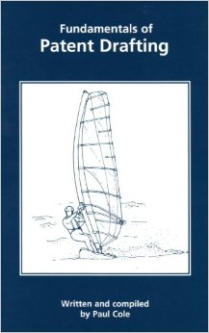

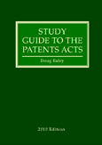
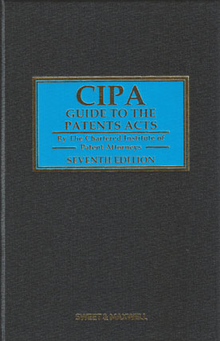
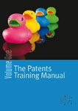

Example CIPA publications

Slide 15
Communications with members and the public
Monthly publication – CIPA Journal
Website with news, comments and information
Email newsletters about upcoming events
LinkedIn forum (over 1500 members); also discussion areas on the website to get input from members
Press releases about institute activities
Annual report

Slide 16
Influencing Legislation
Good connections with law makers
  Meet with them
  Participate in consultations
  Give evidence to UK government
    e.g. European Scrutiny Committee
Lobby members of European parliament
Publish letters in national newspapers
Take part in national radio programmes

Slide 17
Influencing Legislation
e.g. Unified Patent Court & Unitary Patent
  Long and detailed campaign on content of regulation and Court agreement
  Recent success with representation rights

Slide 18
International Liaison
Asia
  JPAA
  ACPAA
  KPAA
  IP delegations
    e.g. Hebei, Yunan, Anhui, Guangzhou, Guangxi, Zhongguancun, & industrial
  Hong Kong Legislature
North America
  AIPLA
  IPIC
Europe
Africa

Slide 19
For more information please contact:
Thank you for your attention!
Chartered Institute of Patent Attorneys
95 Chancery Lane, London WC2A 1DT
Telephone: +44 (0) 207 405 9450
Email: info@cipa.org.uk
www.cipa.org.uk
IN ASSOCIATION WITH
Supporting logos to go in this box if there aren’t any please delete the box and text

